Slide 1
Cloudburst Prediction System
PIP4004 University Project
Final Review
Batch Number: CSE-G121
Roll Number | Student Name
20211CSE0413 | Sushma M Maddin
20211CSE0421 | Sinchana A U
20211CSE0437 | K H Srujan Gowda
Under the Supervision of,
Ms. Rakheeba Taseen
Assistant Professor
School of Computer Science and Engineering
Presidency University
Name of the Program: CSE
Name of the HoD: Dr. Asif Mohammed H.B
Name of the Program Project Coordinator:
Name of the School Project Coordinators: Dr. Sampath A K

Slide 2
Introduction
A cloudburst is an extreme weather event characterized by sudden, heavy rainfall over a small geographic area in a short period of time.
Cloudbursts can cause flash floods, landslides, and significant loss of life and property, especially in mountainous regions.
Due to their unpredictable nature and localized impact, accurate prediction is a major challenge in meteorology.
This project aims to develop a machine learning-based Cloudburst Prediction System using real-time weather data and historical patterns.

Slide 3
Literature Review
Various models have been explored for rainfall and extreme weather prediction:
LSTM (Long Short-Term Memory): Efficient in learning time-series dependencies but may suffer from overfitting and high training time.
XGBoost: A gradient boosting algorithm with high predictive performance but less efficient with sequential data.
Hybrid Models: Some studies combined LSTM with other models like SVM, GRU, or Random Forest for improved accuracy.
Data Challenges: Many papers highlight limitations such as imbalanced datasets and lack of localized weather data.

Slide 4
Existing method Drawback
Traditional meteorological models rely on numerical simulations which are computationally intensive and lack real-time adaptability.
Single-model ML approaches like LSTM or XGBoost alone may not effectively capture both sequential and feature-level patterns.
Poor handling of class imbalance — cloudburst events are rare, causing bias in prediction results.
Limited explain-ability of models – most models fail to provide insights into why a prediction was made.

Slide 5
Proposed Method
The proposed system will be a web-based application integrated with a Machine Learning (ML) model to predict cloudbursts based on meteorological data. The system will include the following features:
ML-Based Prediction Model: A trained model will analyze historical and real-time weather data to predict the probability of a cloudburst occurring. The model will continuously update its predictions as new data is provided.
User Input Form for Manual Data Entry: The website will have a simple form where users can manually enter weather parameters if real-time data is unavailable or if they want to test different scenarios.
Automated Alert System: The system will send SMS, email, or push notifications to warn users when a high probability of a cloudburst is detected, allowing for early action and disaster preparedness.
User-Friendly Web Interface: A simple and interactive web dashboard will allow users to input data, view predictions, and receive alerts easily. The interface will be designed to be accessible to disaster management teams, meteorologists, and local authorities.

Slide 6
Objectives
The key objectives of this project are:
To develop an ML-based system capable of predicting cloudbursts using meteorological data.
To collect and preprocess historical and real-time weather data for training the model.
To implement a web-based interface for user-friendly weather data input and predictions.
To integrate an alert mechanism (SMS, email, push notifications) to notify users of potential cloudbursts.
To enhance early warning systems for better disaster preparedness and mitigation.

Slide 7
Methodology/Modules
Phase 1: Data Collection & Preprocessing
Gather historical meteorological data from reliable sources (e.g., IMD, NOAA, NASA).
Fetch real-time weather data via APIs or manual input.
Clean and preprocess the data (handling missing values, normalization, feature selection).
Phase 2: Machine Learning Model Development
Train different ML models (e.g., Decision Trees, Random Forest, SVM, Neural Networks).
Evaluate models using performance metrics like accuracy, precision, recall, and F1-score.
Optimize and fine-tune the best-performing model for cloudburst prediction.
Phase 3: Web Application & Alert System
Develop a web application for user input and predictions.
Integrate an alert system (via SMS, email, or push notifications) to warn users.
Deploy the system for real-time usage and continuous improvement.

Slide 8
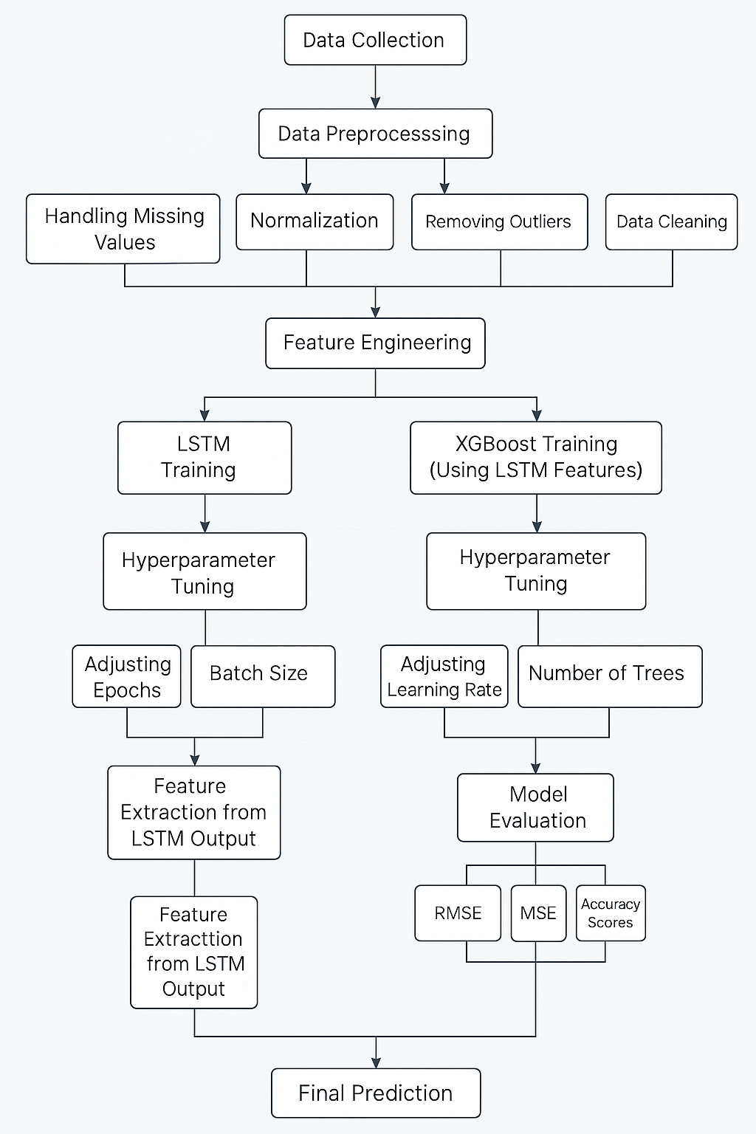
Architecture

Slide 9
Hardware/software components
1. Frontend (Web App)
React.js → For building the UI
CSS → For styling
Axios → To send data to the backend
2. Backend
Flask (Python) → To handle requests and run the ML model
Node.js + Express (Alternative) → To handle the JavaScript

Slide 10
Hardware/software components
3. Machine Learning (Model Training & Prediction)
Python → Core language for model development
Libraries:
Pandas, NumPy → Data processing
Scikit-learn → ML algorithms
Matplotlib, Seaborn → Data visualization
4. Software & Tools
OS → Windows
VS Code / Jupyter Notebook → For development
Postman → For testing
Git & GitHub → Version control
Kaggle → For the dataset

Slide 11
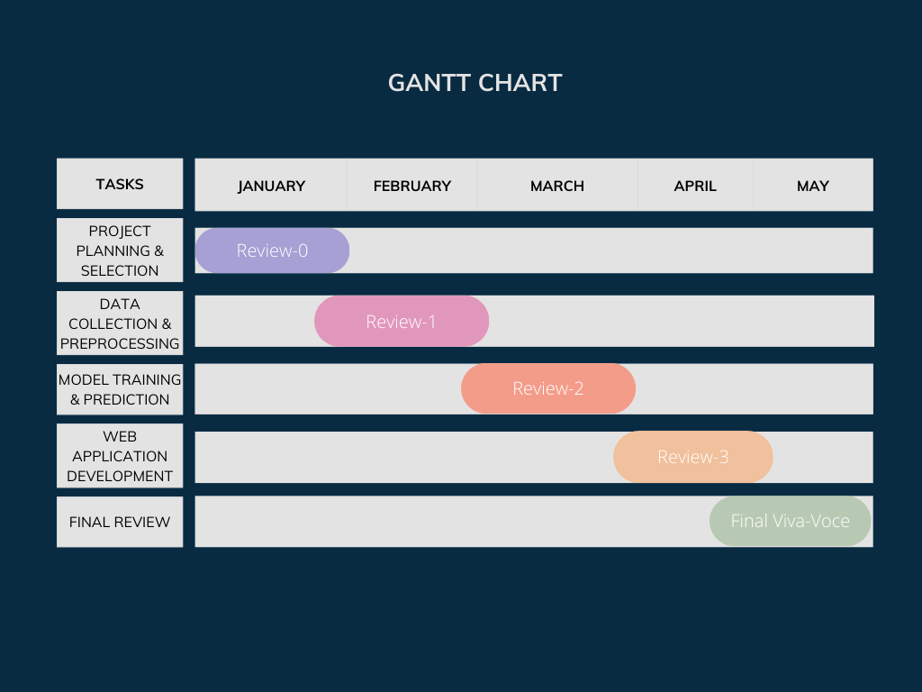
Timeline of Project

Slide 12
Expected Outcomes
Accurate Cloudburst Predictions: A trained Machine Learning (ML) model capable of predicting cloudbursts based on real-time and historical meteorological data, improving early warning capabilities.
User-Friendly Web Application: A simple and intuitive web-based interface where users can enter weather parameters manually or rely on real-time API data for predictions.
Improved Disaster Preparedness: By providing real-time alerts and warnings, the system will help authorities, meteorologists, and local communities take preventive measures, reducing the impact of cloudbursts.

Slide 13
Conclusion
Cloudbursts are unpredictable and highly destructive weather events that often result in severe flooding and loss of life. Traditional weather forecasting models struggle to provide accurate and timely warnings due to the localized nature and sudden onset of these events. This project aims to bridge the gap in cloudburst prediction by leveraging Machine Learning (ML) techniques and real-time meteorological data analysis. By utilizing historical weather data and live inputs, the trained ML model will enhance forecasting accuracy and provide data-driven insights for better preparedness. A key innovation of this project is the integration of a web-based application that allows users to manually input weather parameters or access real-time data for automated cloudburst predictions. Additionally, the system will feature an automated alert mechanism, notifying relevant stakeholders via SMS, email, or push notifications in case of high-risk weather conditions. This proactive approach will enable disaster management authorities, meteorological departments, and local communities to take timely preventive measures, minimizing the potential damage caused by cloudbursts. The successful implementation of this system has the potential to significantly improve early warning capabilities, reduce casualties, and mitigate economic losses caused by extreme weather conditions. Furthermore, this project contributes to the broader field of AI-driven climate prediction and can be extended to other extreme weather forecasting applications, such as storm prediction, flash flood warnings, and climate anomaly detection. By combining advanced ML models, real-time data processing, and an intuitive user interface, this system represents a step forward in modernizing disaster preparedness and response strategies, ultimately helping to save lives and protect valuable resources.

Slide 14
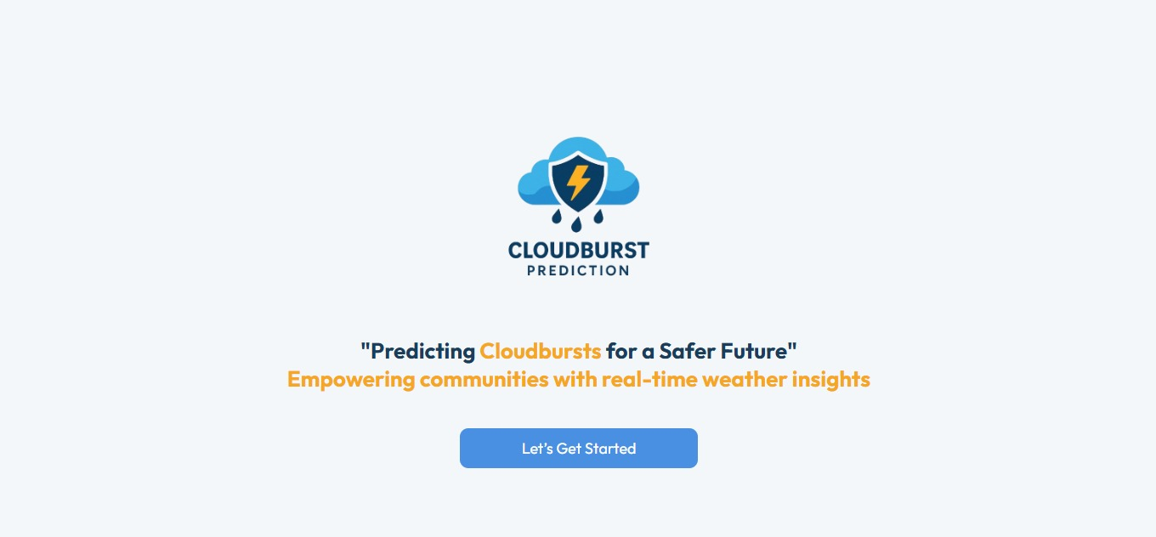

Results:
Home Page
Sign In Page

Slide 15
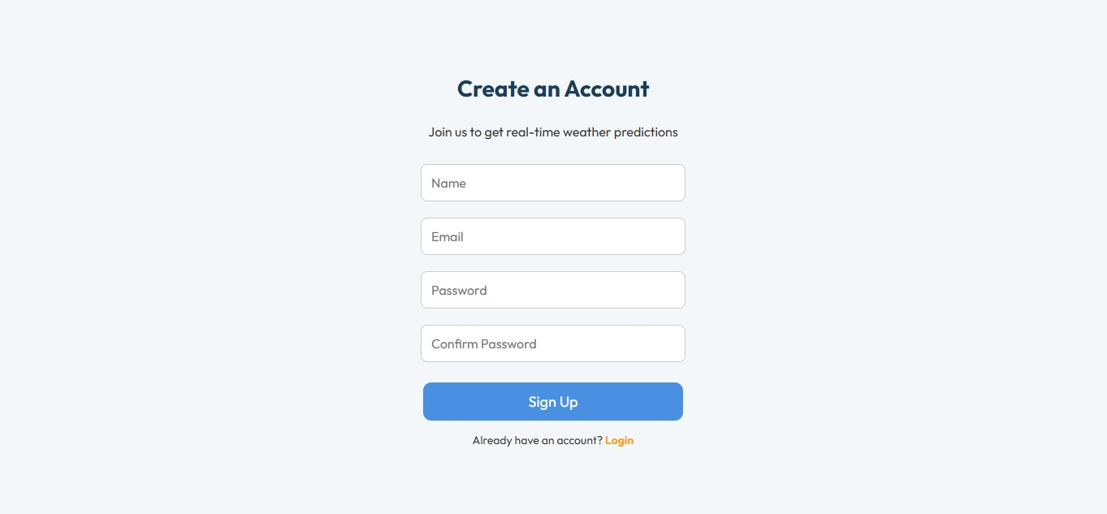
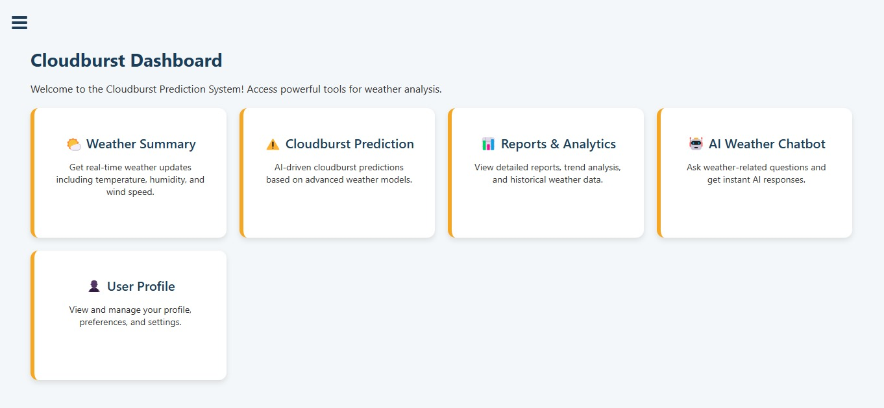
Results:
Sign Up Page
Dashboard

Slide 16
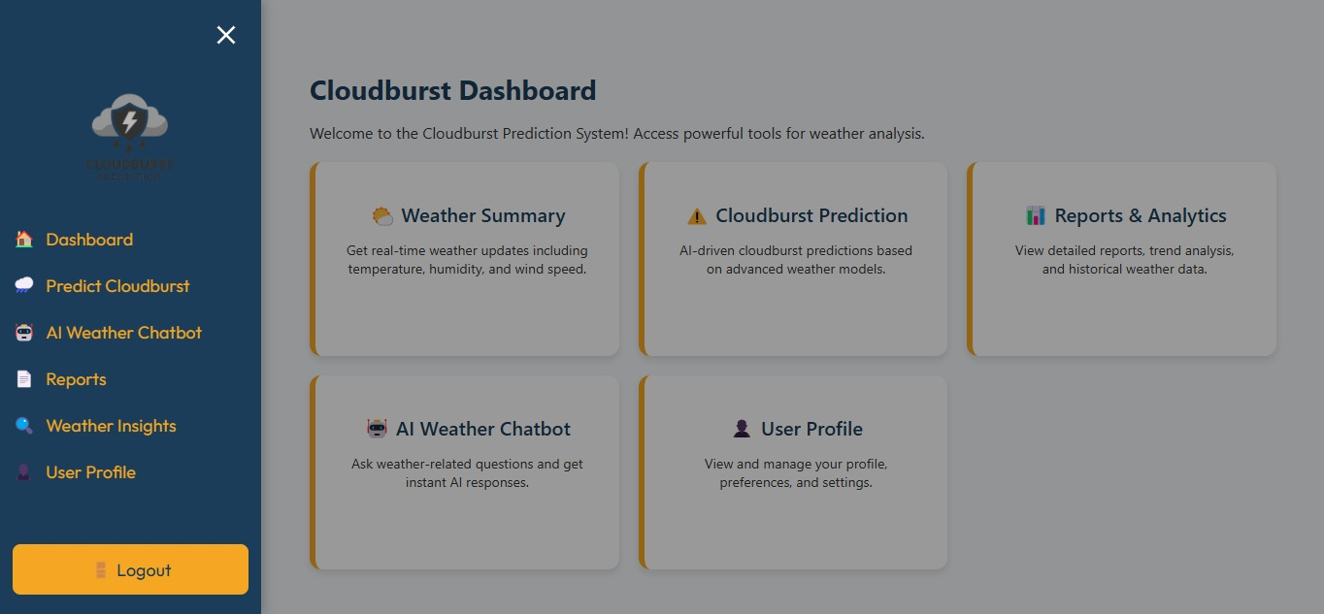
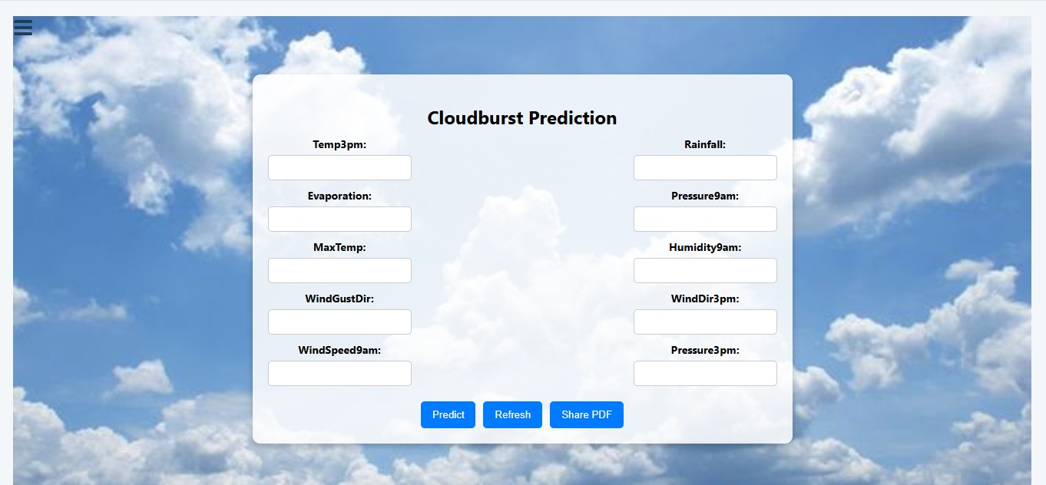
Results:
Sidebar Navigation
Prediction Form

Slide 17
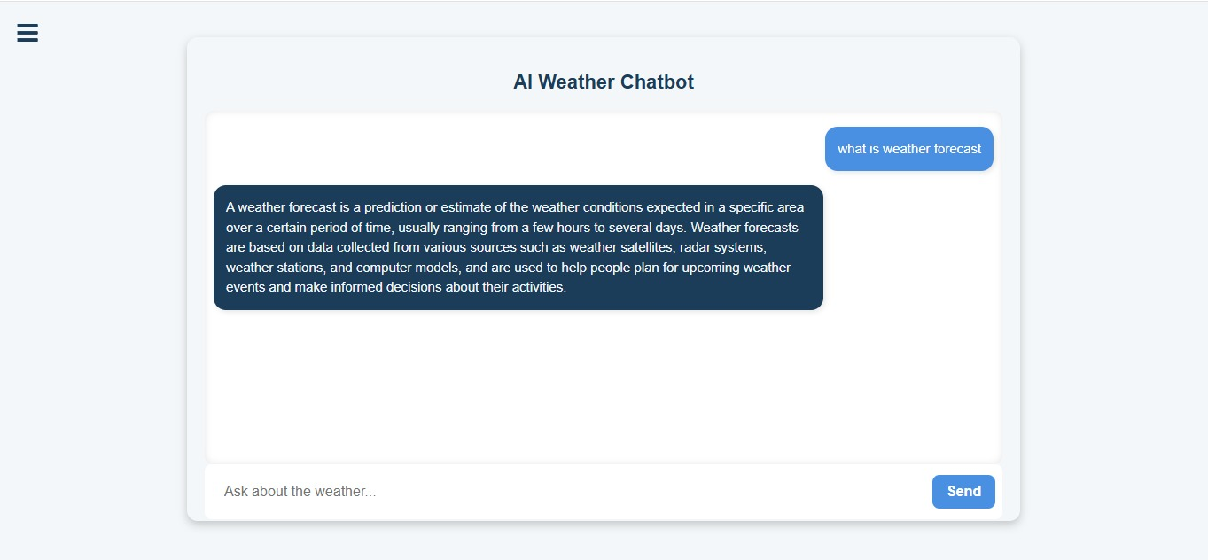
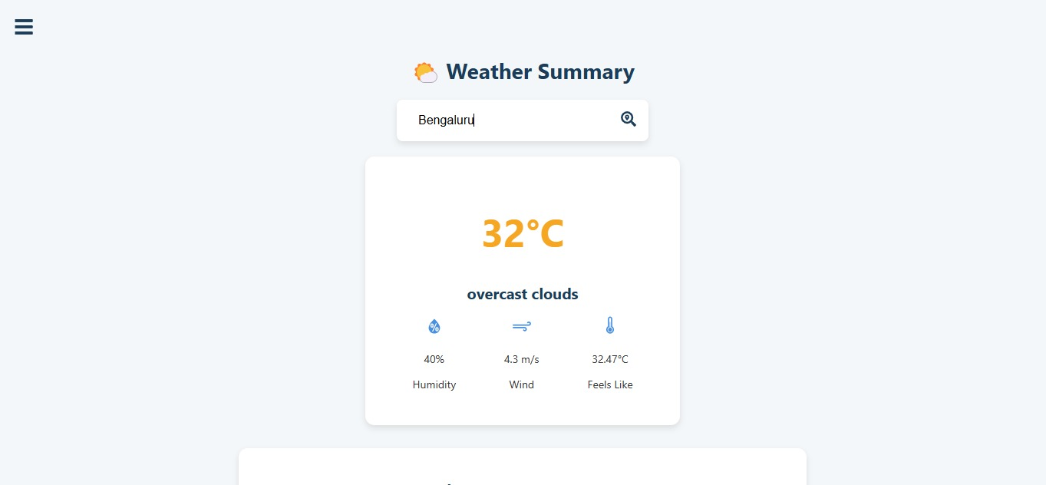
Results:
AI Chatbot
Weather Insights

Slide 18

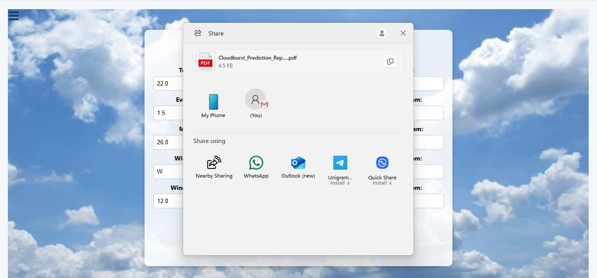
Results:
Profile Page
Share Screen

Slide 19
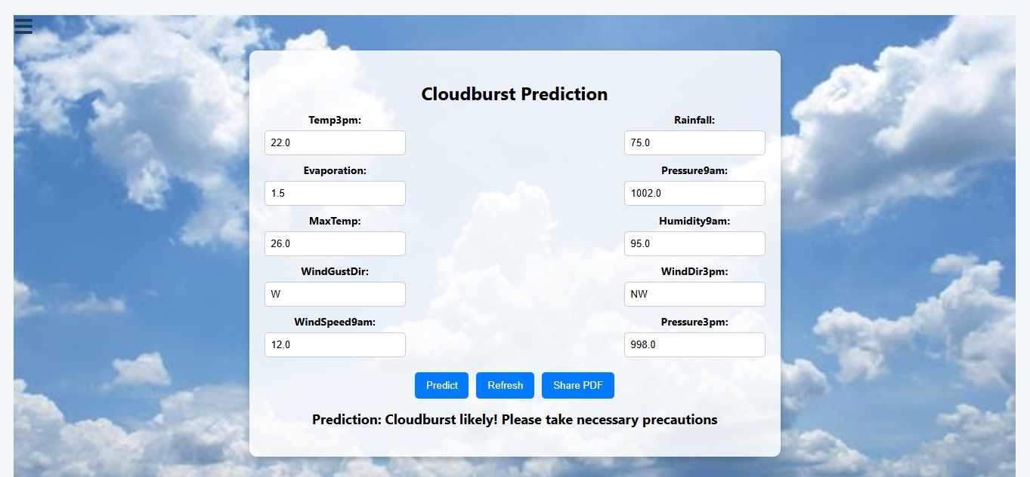
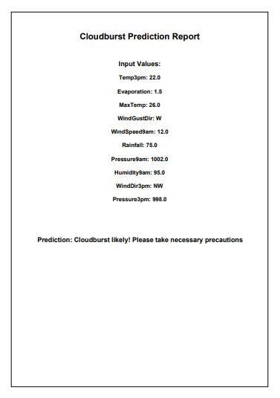
Results:
Cloudburst Prediction
Cloudburst Prediction Report

Slide 20
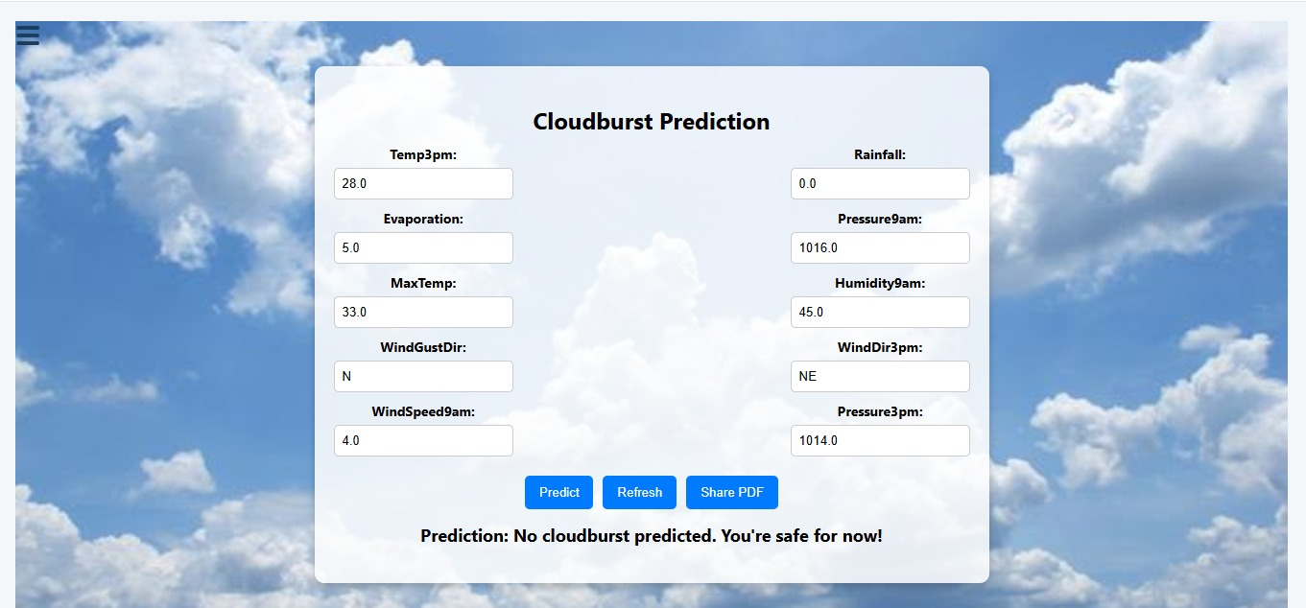
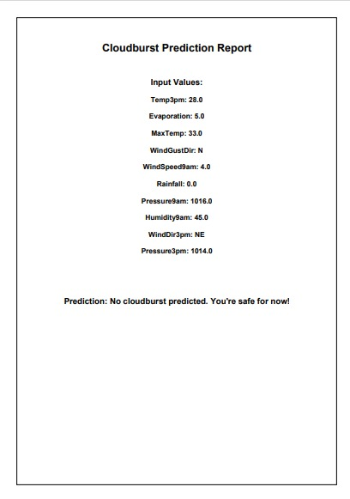
Results:
No Cloudburst Prediction
No Cloudburst Prediction Report

Slide 21
Github Link
https://github.com/Sushma-M-Maddin/PSCS_91_CSE121-cloudburst-prediction-system

Slide 22
References
[1] D. Knos, K. Karagiorgos, J. Haas, B. Blumenthal, L. Nyberg, and S. Halldin, “Cloudburst-disaster modelling: A new open-source catastrophe model,” Centre for Societal Risk Research, Karlstad University, Sweden, 2022.
[2] D. Karunanidy, P. S. Rakshith, G. Sireesha, N. M., M. Kumar, and M. Sreedevi, “Cloudburst Prediction in India Using Machine Learning,” IEEE, 2023.
[3] A. S. Raghuvanshi, R. M. Trigo, and A. Agarwal, “Climatology of extreme precipitation spells induced by cloudburst-like events during the Indian Summer Monsoon,” Department of Hydrology, IIT Roorkee, India, 2021.
[4] A. Tejaswini Reddy, B. Venkatesh, and S. Reddy, “Cloudburst Prediction in India Using Machine Learning,” Anurag University, Telangana, India, 2023.
[5] S. Telsang, P. Sawale, S. Pujari, V. Pujari, A. Pungale, R. Dubewar, and R. Shendre, “Cloudburst Prediction System Using Machine Learning,” Vishwakarma Institute of Technology, Pune, India, 2022.

Slide 23
References
[6] A. Tiwari and S. K. Verma, “Cloudburst Predetermination System,” Department of CSE, GBPEC, Pauri, India, 2022.
[7] G. G. A., A. Anjum, G. N. Hegde, G. S. V., and G. N. Hegde, “The Cloudburst Prediction System,” City Engineering College, Bangalore, India, 2022.
[8] S. M., R. P., and B. A., “Sequence Model based Cloudburst Prediction for the Indian State of Uttarakhand,” VIT Chennai, India, 2023.
[9] S. Das, R. Ashrit, and M. W. Moncrieff, “Simulation of a Himalayan cloudburst event,” National Center for Medium Range Weather Forecasting and National Center for Atmospheric Research, India and USA, 2021.
[10] B. R. Reddy, S. Anchuri, K. Santhi, P. Perugu, S. Depuru, and M. S. Kumar, “Enhancing Cloudburst Prediction System Using Bi-LSTM in Realtime: Machine Learning,” Canadian Journal of Advanced Networking and Applications (CANA), vol. 32, 2023.

Slide 24

Project work mapping with SDG

Slide 25
Project work mapping with SDG
The Cloudburst Prediction System contributes to several UN SDGs by leveraging AI and ML to predict extreme weather events and enhance disaster preparedness:
SDG 13 – Climate Action: Enables early warning and proactive response to cloudbursts, improving climate resilience.
SDG 9 – Industry, Innovation, and Infrastructure: Integrates real-time data and AI for smart disaster management and infrastructure planning.
SDG 11 – Sustainable Cities and Communities: Supports urban planning, risk reduction, and emergency preparedness in flood-prone areas.
SDG 12 – Responsible Consumption and Production: Aids farmers and industries in optimizing water use and minimizing weather-related losses.
SDG 17 – Partnerships for the Goals: Encourages collaboration among scientists, agencies, and institutions for climate adaptation.

Slide 26
Thank You

